Slide 1
Sprint triathlon
Group 1:
Jenni, Griffin, Angaya

Slide 2
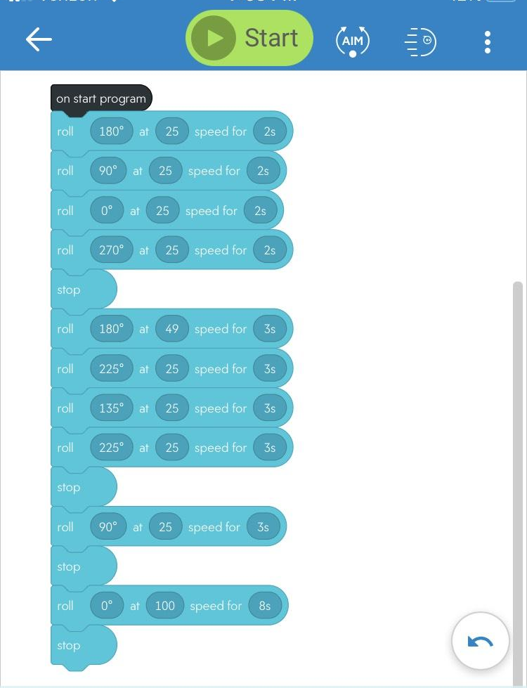
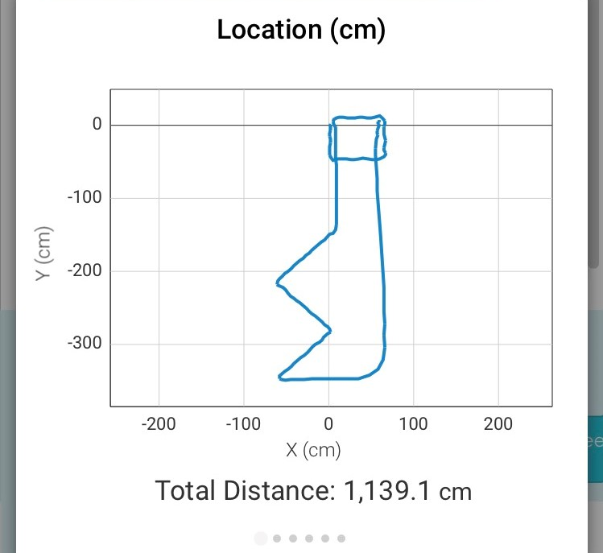
Sprint 3: Agility
Block Code
Sensor Data Diagram

Slide 3
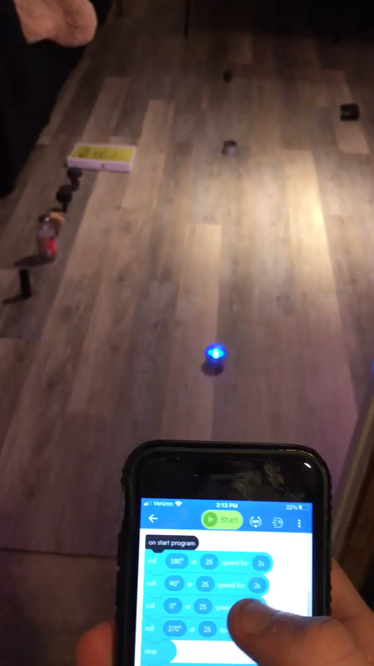
Video of Sprint 3

Slide 4
What we learned
What we would do differently
Since we could not physically meet, we had to be in constant communication
We had to divide responsibilities to make sure everything in the project got completed
We realized that we would not get everything right on the first attempt
The more specific the functional requirements were, the more challenging it was to create the an effective program.
We could have worked on our time management
Ran into a couple problems that were, unexpectedly, more time consuming
Be more organized in creating the SDD
Change individual roles in the project every sprint

Slide 5
Challenges Faced
Robot not connecting to bluetooth
Robot not being consistent with its movement
Program
Aim feature
Block code
Space
The surface
Lack of resources (specifically in agility course)

Slide 6
Roles of each team member
Jenni:
Complete the SDD
Flowcharts
Creating the GitHub Repository
Griffin:
Owner of the robot
Programmed the robot/censor data
Course set up
Angaya:

